Slide 1
Miranda R
projektledning och entreprenörskap
få alla projektmedlemmar att förstå:
You need to present a reason why people should do as you want.
Scorecards are tools for communication.
.. the map allows all the team members, and then all the stakeholders, to collaboratively and iteratively see and reflect upon a set of complex relationships ..

Slide 2
Mathias L
Supply Chain Management
man visualiserar olika vägar (”paths”):
Every organisation should pursue a unique strategy, based on its interpretation of the external and internal situation. [’strategic themes’]
.. the usability effects on ... core values have to be discernible in a way that allows for collaborative interpretation, negotiation, decision making and follow-up of usability metrics.

Slide 3
Harald V
entreprenörskap och projektledning
arbetet fortskridit utan att någon har det övergripande ansvar:
... should provide an overview of the organization’s most important value-creating resources and processes.
They enable discussion about cause-effect relationships when facing strategic decisions, and about possible strategic actions.

Slide 4
Andreas M
strategy & support functions (IT)
for management and stakeholders to realize the value:
Scorecards are very useful for discussing internal support functions ... Deciding that such extensive and expensive functions are needed, by articulating the links to expected benefits and their impact on profits.
... to agree on targets for, and monitor, their organization’s performance in dimensions other than the traditional monetary ones.

Slide 5
Mattias N
project management
visualize for ... stakeholders ... before (!) it is started:
why we believe we will succeed
...if the relation between high implementation costs and high profit levels is consistently weak, it can be inferred that the project ... does not sufficiently contribute ...

Slide 6
Erik B
start-up Help to Help
koppla samman verksamhetens mål och visioner med aktiviteter och mätetal:
Scorecards are used to align business activities to the vision and strategies of a firm, monitoring performance ... and taking action ...
... enabling employees to understand the organization’s situation. They also provide information for managers ...

Slide 7
Helene H
projektledning
att lättare kunna mäta resultat utifrån vision:
Scorecards are used to align business activities to the vision and strategies of a firm, monitoring performance ... and taking action ...
... the maps clarify that powerful ICT services is not a goal unto itself ...

Slide 8
Åsa B
iSpexet
saknas en kontinuerligtet i ledarskapet:
... help in structuring strategy discussions and deriving concrete targets for all parts of the organization
help build a long-term involvement of physicians, management, procurers and systems providers by offering a key activity in which they can negotiate their respective expectations

Slide 9
Claes T
styrning i storföretag
vilka processer som man skall arbeta med när kundernas aspekter har identifierats
kommunicera idéer om orsak &verkan samt prioriteringar
åskådliggöra synergieffekter med övriga avdelningar
hitta samband och synergier i de ”lägre” perspektiven

Slide 10
Eric B
vad som är värdeskapande i vår produkt
... some scorecards projects result in a ‘proposal’ from a subsidiary to corporate management about the role it wants.
vilka kompetenser vi har i projektet och hur vi kan vidareutbilda oss själva eller kanske ta in nya projektmedlemmar ...

Slide 11
Oskar M
Avanza förnyar sin tekniska plattform
externa samarbetspartners:
... to map out, collaboratively, the interplay between planned development efforts, their anticipated effects in the work process and the value fulfillment these effects represent for different stakeholders/participants.
... How to move away from short-term thinking and instead link it to long-term. And to actually put the plans into action.

Slide 12
Björn S
agil project management
In short I want to use BSC and strategy mapping to:
• Visualize the business and the internal project steps in order to enhance productivity and increase understanding of the company's role.
• Get better requirement specifications and aligning customer expectations with possibilities through mapping sessions. (through the process not necessarily the maps themselves)

Slide 13
Olof S
entreprenörskap och finansiering
två nyckelområden – lärande och genomförande:
Developing the scorecards usually makes people see their company and its business model in a new way. This often leads to ... a reconsideration of its strategy.
... the activity to iteratively map out, visually, the set of design patterns selected for making the solution meet declared user needs and values. (­­­) They may be sketches rather than thoroughly worked out analysis of all aspects

Slide 14
Kattarina H
företagsstrategi och projektledning
STÄRKA KOMMUNIKATION
A scorecard is an easy-to-understand generic format ... for:
Communicating strategic intensions, enabling managers and employees to realize intended strategies
FÖRTYDLIGA SAMBAND
Discussing activities that are motivated by strategic aims rather than current necessities
MÄTA OCH EVALUERA
Monitoring and rewarding such activities

Slide 15
Emma P
inom föreningslivet
inte någon tydlig koppling mellan verksamhetens värderingar – mål och faktiskt arbete. Underlag till diskussion.
Drawing such scorecards as strategy maps often makes it easier to discuss the intended business logic.
All employees shoud see clearly how the company’s vision and overall goals affect day-to-day operations.

Slide 16
Christian D
smartphone application development
coordination of multiple different activities with numerous programmers and designers
assist in finding and selecting metrics to monitor activities
a simplified overview of an organization's strategy and how it is intended to play out over time
could be used to articulate well­specified critique of a system in use

Slide 17
Gustav R
IT-projekt – projektledning
att alla i teamet jobbar mot samma mål och vet vad projektets intressenter värderar
we sometime use maps almost as simple as this to trigger discussion in a group of executives asking, for instance, which theme is the most important one
to map out, collaboratively, the interplay between planned development efforts, their anticipated effects in the work process and the value fulfillment these effects represent

Slide 18
Niklas N
digital product development
to mediate idéas and values rather than enforcing strict surveillance and control
A number of firms use scorecards as a format for discussing strategies only, and have not really introduced them as a tool for ongoing management control.
to identify weaknesses in systems use...
to rank importance of system effects...
to elicit new needs and opportunities...
to complement existing methods for collaborative reflection on system design

Slide 19
Erik A
evaluering inom Operations Management
vilket latent behov systemet är tänkt att uppfylla och hur väl det faktiskt uppfylls
align business acitivities to the vision of the firm, montoring performance in the dimensions used in scorecards, and taking action
provide a valuable tool for enabling employees to understand the organization’s situation. They also provide information for management ... document on a continuous basis those measures for control which most quickly will guide ...

Slide 20
Simon W
League of Legend teams (!)
show employees their contributions – motivate – give overview
Discussing activities that are motivated by strategic aims rather than current necessities, such as the development of competencies, customer relationships, and IT
Managers need tools to communicate about intangible or immaterial assets: to agree on targets for, and to monitor, their organization’s performance in dimensions other that the traditional monetary ones.

Slide 21
Dan J
entreprenörskap
entreprenörens vision som det klister som kopplar samman kompetenserna
to map out, collaboratively, the interplay between planned development efforts, their anticipated effects in the work process and the value fulfillment these effects represent
visualiseringsmetod för en entreprenör:
1. Fyra perspektiv ger en helhetsbild
2. koppla utvecklingsarbete och hur stakeholders påverkas
3. gemensam syn på ftg:s riktning på längre sikt
4. Koppla (bryta ner) visioner och mål till det dagliga arbetet.

Slide 22
Poyan N
entrepreneurship – start-ups
Plans are nothing; planning is everything
Scorecards aim to change behaviour through communication in order to realize the intended strategy.
We believe that a large number of the employees, probably the majority should know about the scorecards and take part in dialogues about them.
+ creating buy­in for the strategy by engaging the stakeholders in prioritising user stories (!)

Slide 23
Hans-Erik Täpp
projektbaserade organisationer (PBO)
orsak-verkan-samband (strategiska teman) för strategic alignment
Den färdiga kartan kan användas för att kommunicera strategier och deras inneboende logik. (Olve et al. 2006 (!))
Strategikartan uppmanar oss, på ett mycket praktiskt vis, att artikulera nya rutiner som skulle ge upphov till önskade effekter i den övergripande arbetsprocessen.
+ en sofistikerad urvalsprocess för start av nya projekt

Slide 24
Joacim O
agile software development
external stakeholder­interests are not taken into consideration
Scorecards are used to align business activities to the vision and strategies of a firm, monitoring performance in dimensions used in the scorecards, and taking action (KPIs clarifies connections)
Scorecards aim to change behaviour through communication in order to realize the intended strategy. (BSC gives transparency)

Slide 25
Olof D
entreprenörskap och change management
bryt ner processerna för att få överblick
By emphasizing the use of visual sketches and providing a formalism for accounting for context, the method helps designers and researchers describe practical solutions to recurrent design problems.
One of the main purposes of the maps is to communicate strategies and their inherent logic. ... To achieve this, a good map...requires huge simplfications. Strategy maps easily degenerate into wishful thinking.

Slide 26
Dennis K
projektledning och operation management
hur vår tekniska design kommer förbättra kärnverksamheten
They provide information for management as the organizations starts to develop and document on a continuous basis those measures of control which most likely will guide it towards achieving its goals and vision.
[stakeholders] ... have to be involved in the ongoing process of conceptualising professional needs against the backdrop of new ICT systems, work routines and organisational patterns.

Slide 27
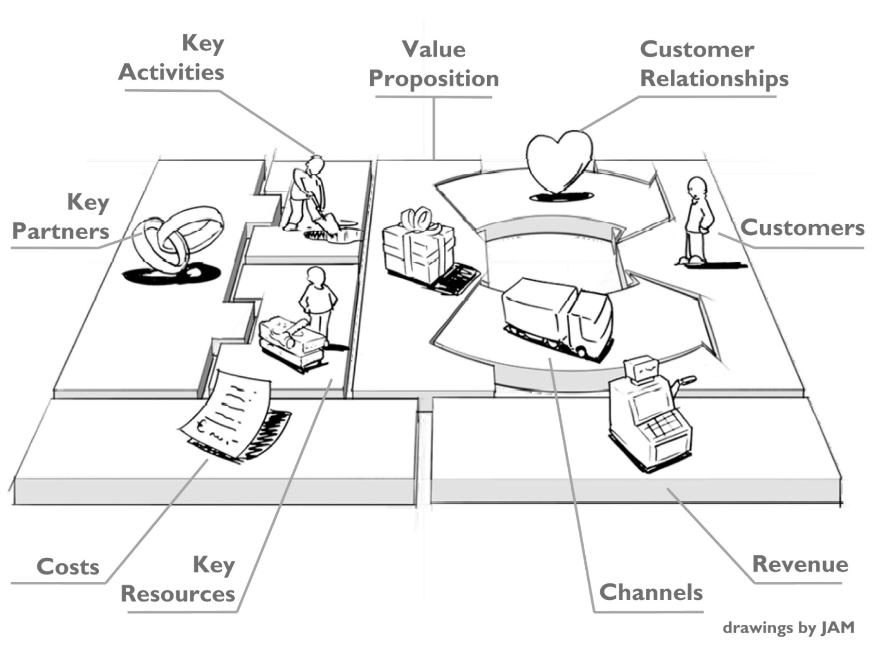
”Affärsmodell” enligt Osterwalder & Pigneur (2010) – utforma värdeskapandet som ett ekonomiskt hållbart system!

Slide 28
